Slide 1
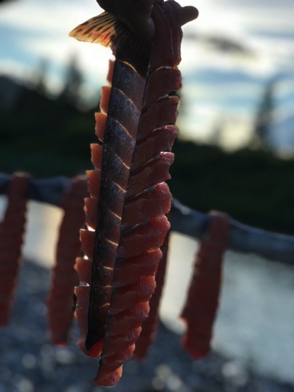


“Advancing the capacity of our People and Tribes for the benefit of the region”

Slide 2
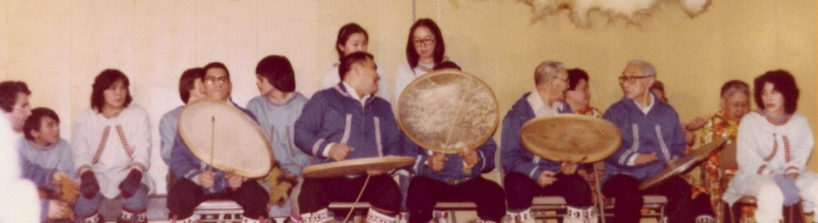
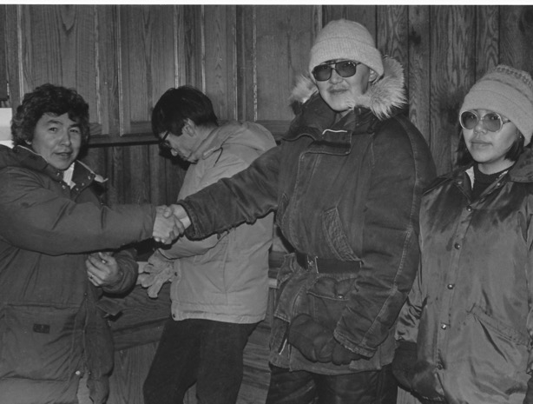
46th Anniversary Year
When established in 1973, Kawerak’s vision was to provide services to the region and to preserve our cultures for the next generations. After 45 years, we are keeping with that vision; we constantly look for new ways to ensure that our people and tribes are thriving now and in the future.

Slide 3
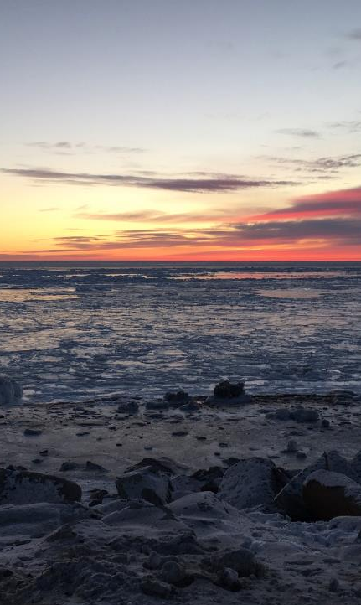
Compact
Kawerak has a self-governance compact with the Department of Interior, and compacts federal funding to provide servcies to 19 of 20 tribes in the region. Nome Eskimo Community compacts independently for their federal funding.
Kawerak’s compact funding represents 1/3 of the total budget. Outside of compact Kawerak receives other federal, state and private foundation funding.

Slide 4
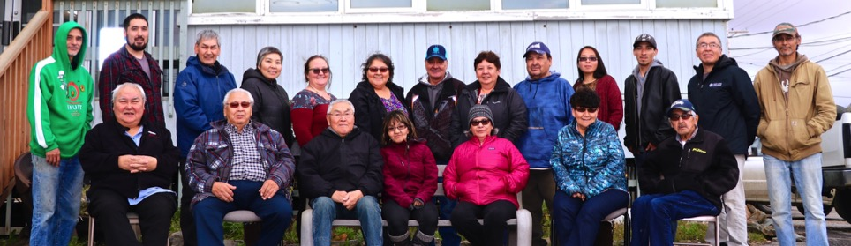
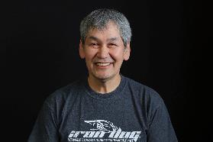
Kawerak Board of Directors
Kawerak Board of Directors consists of the Council Presidents or appointed delegates of the 20 federally recognized tribes, two Elder representatives and the chair of the Norton Sound Health Corporation Board.
Board Chair Frank Katchatag

Slide 5
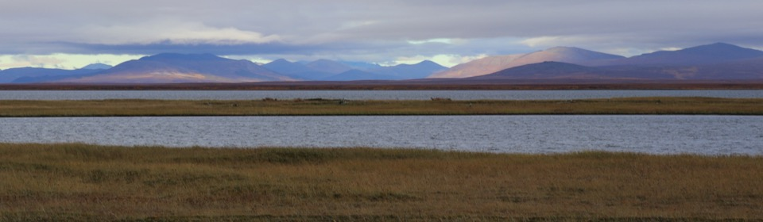
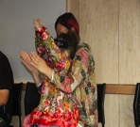
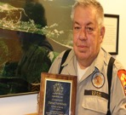
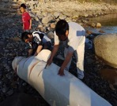
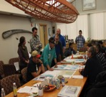
Strategic Priorities 2016-2020
Culture and Language
Public Safety and Well-being
Arctic Resource Enhancement and Protection
Regional and Internal Capacity Building

Slide 6
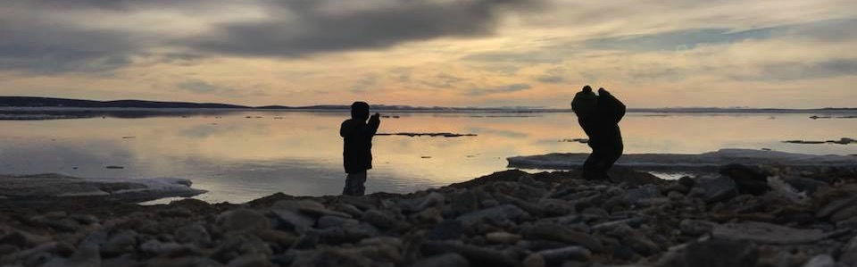

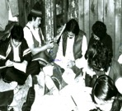
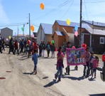
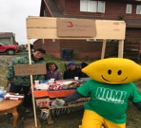
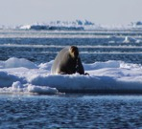
Divisions
Administration
Cultural & Regional Development
Community Services
Employment, Education and Supportive Services
Natural Resources

Slide 7
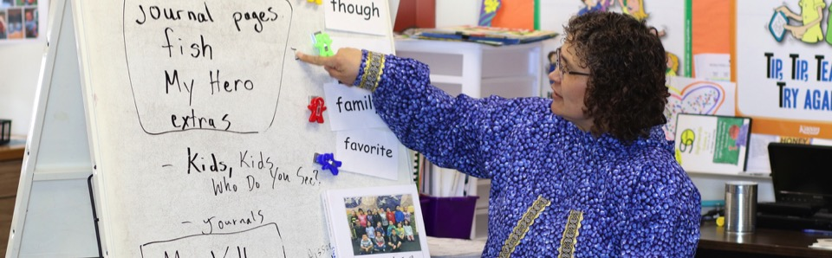
Education Employment and Supportive Services
Head Start/Early Head Start/Child Care
Child Care Assistance & Licensing
Community Education/GED Program
Employment & Training Program
Education Development Services
Caleb Scholars Program
Workforce Development Services
Vocational Rehabilitation Program
Direct Employment
Supportive Services
Higher Education
Vocational Training
Village Based Training
General Assistance
Summer Youth Work Program & Apprenticeship

Slide 8
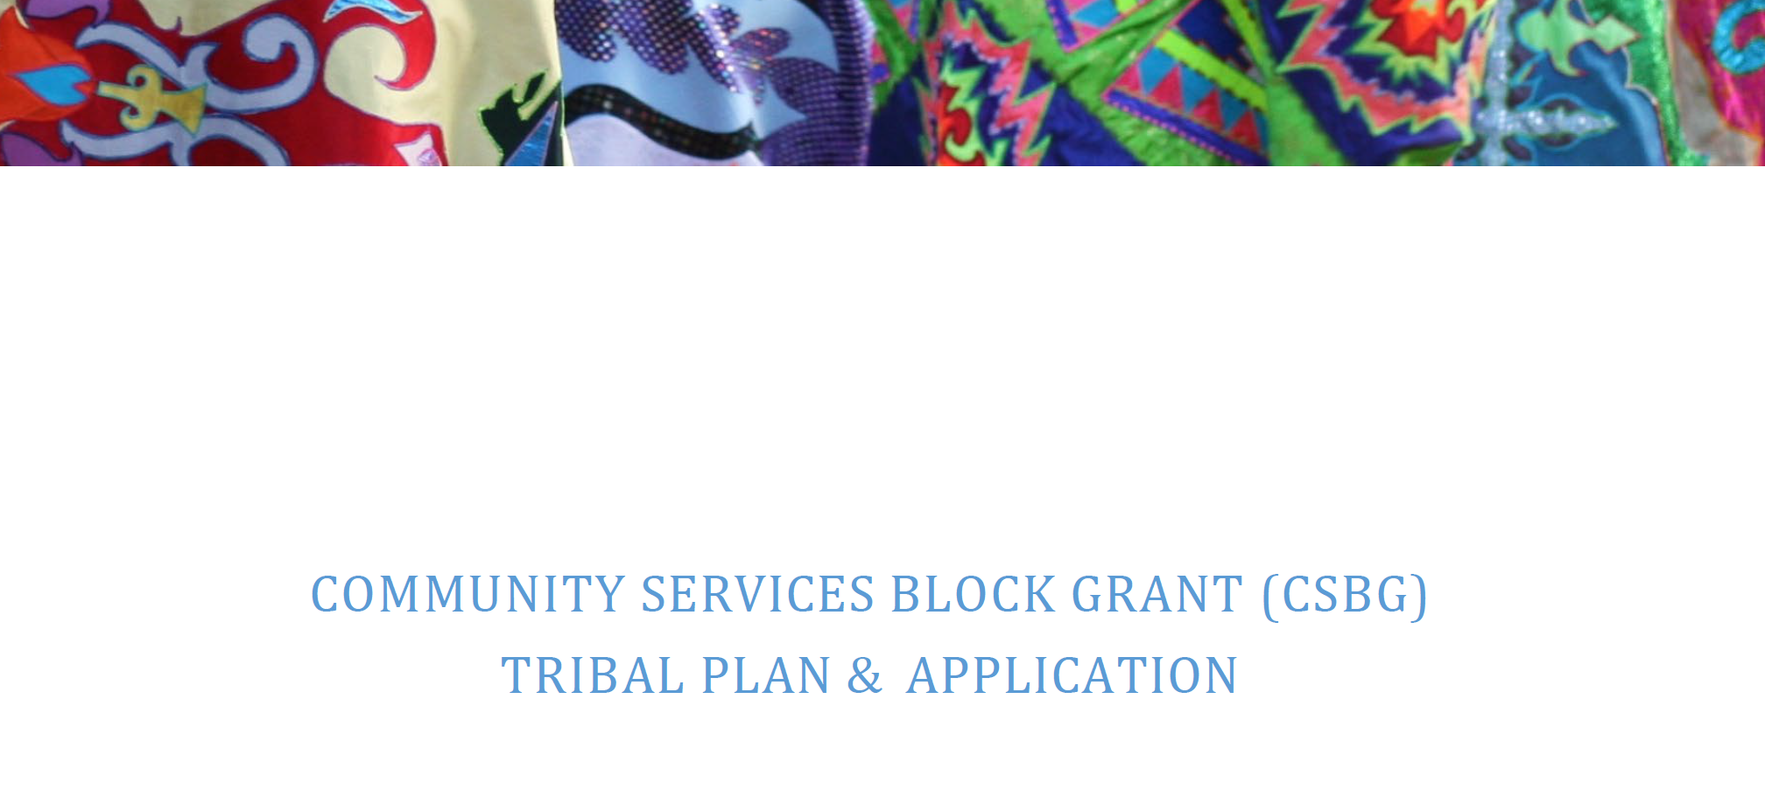

Slide 9
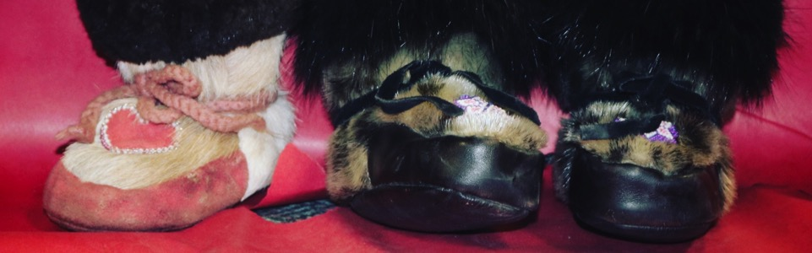
Goal
To support activities that assist low-income, unemployed, underemployed, homeless individuals, through a wide variety of services that promote and lead to self-sufficiency reducing poverty and joblessness within the communities we serve. The potential benefits of achieving self-sufficiency through employment includes income, economic options, enhanced self-worth, and serving as a needed role models for children, as well as contributing to the community through work and reducing poverty. This goal aligns with the mission of Kawerak, which is to serve low-income Alaska Native families and youth, working to “advance the capacity of our people & tribes for the benefit of our region.”

Slide 10
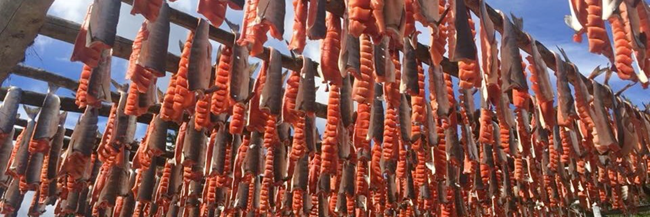
Objectives
Objectives:
1. To provide opportunities for Tribal members to take part in job training, work and education related activities that lead to economic self-sufficiency. We will encourage Tribal members to support their children by preparing for, accepting and retaining employment.
2. To improve the quality of services offered by Kawerak EESS Division for the
Tribal members of the Bering Strait region by expanding access to sustainable
funding.

Slide 11
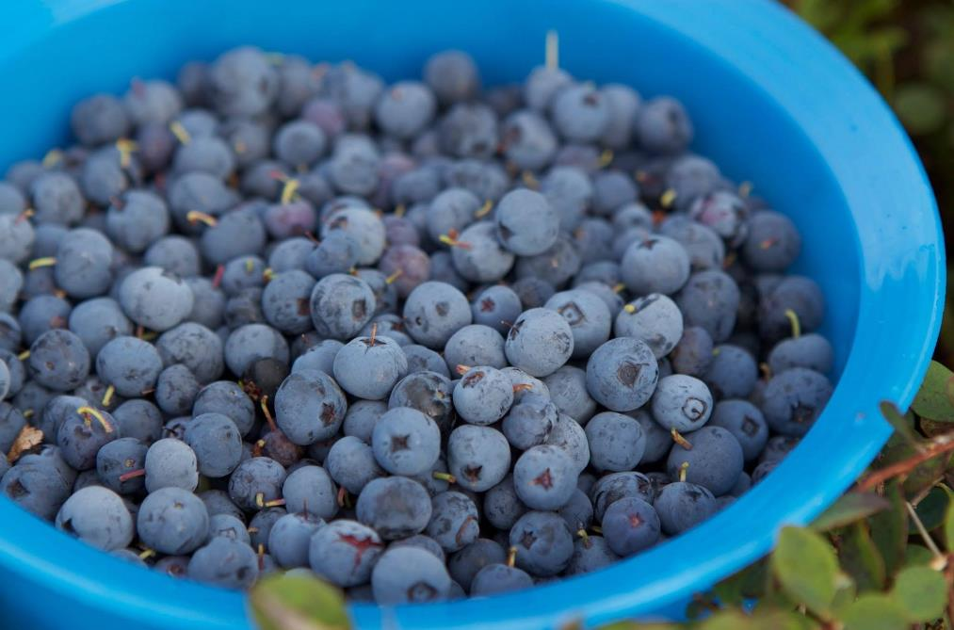
Objectives
3. To improve partnerships with other community organizations which support our participants and mission, through collaboration and support of their community projects and goals.
4. To provide information, capacity building through consultation and technical assistance/advising, and facilitating collaborative programs and service delivery among the Tribal communities primarily within Bering Strait region, through its partnerships with the nonprofit Tribal affiliate organizations and Tribal Councils.
5. To provide coordination and outreach within the region through newsletters, public outreach, and social media.

Slide 12
Targeted Communities
Brevig Mission, Council, Diomede, Elim, King Island, Gambell, Golovin, Koyuk, Mary’s Igloo,, St. Michael,, Shaktoolik, Shishmaref, Solomon,, Teller, Unalakleet, Wales, White Mountain
Nome Eskimo, Savoonga, & Stebbins are provided services through RurAL CAP

Slide 13
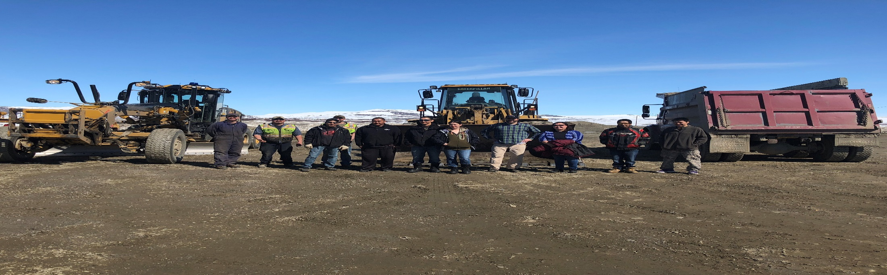
Activities
1) Develop and expand existing training programs in high-growth industries and where there is a need for employees.
2) Provide coordination and outreach for services via newsletters, radio announcements, public outreach, and social media.
3) Collaborate with regional organizations to understand regional economic development and create strategies to address them.
4) Establish, collaborate and improve partnerships with other community organizations and partners who support our participants self-sufficiently goals.
5) Remove obstacles that will enable tribal members to secure employment through support services. Support includes but not limited job placement, training, work experience, and youth internships, tuition, grants, application fees, tools and clothing.

Slide 14
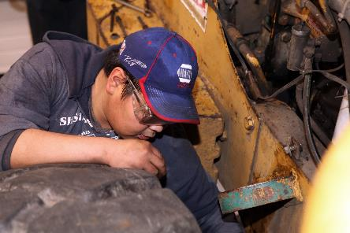
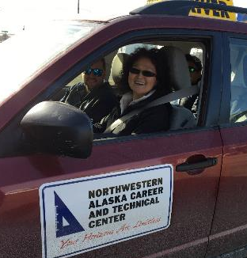
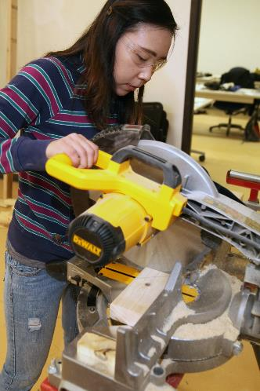
Activities
6) Provide Family Self-Sufficiency Assistance, including GED and Adult Education, Child Care, Personal Finance classes, family-focused support and Elder referral services.
7) Promote services for Elders and their caretakers, including but not limited to educational and informational workshops with program partners.
8) Provide reentry referral services to participants with the assistance of our program partners, services include: support group services, employment and training, and assisting former inmates with accessing basic need services.
9) Support Collective Impact Initiatives for Growing our own Teachers and Nurses in the region that support, train and employ the local workforce for jobs located in the villages.

Slide 15
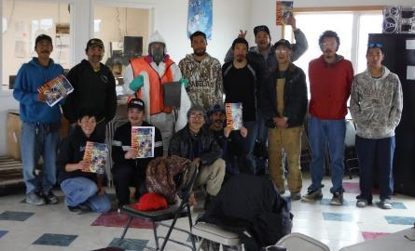
Activities
10)Improve internet access for distance delivery for instruction and support services for rural communities.
11) Promote the creation of Alaska Native Small businesses and support existing Alaska Native small businesses.

Slide 16
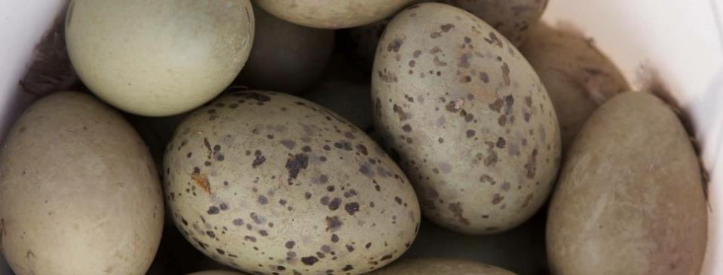
Partners
Norton Sound Health Corporation, Norton Sound Economic Development Corporation, Northwestern Alaska Career & Technical Center, Bering Straight Regional Housing Authority, UAA-Northwest Campus, Local employers, City and Tribal offices, etc.
Through partnerships, Kawerak has successfully collaborated to provide training opportunities by pooling financial resources to share training costs and that offer a credential and prepare people for employment by assisting in the development of work readiness, academic skills and career awareness essential to success in the workplace.
As a result of such collaborations, students receive opportunities to explore and be exposed to training programs aligned with Alaska’s priority industries such as Introduction to the Heavy Equipment, Welding, and Facilities Maintenance to name a few. The funding would increase the number of students receiving regional short-term training.

Slide 17
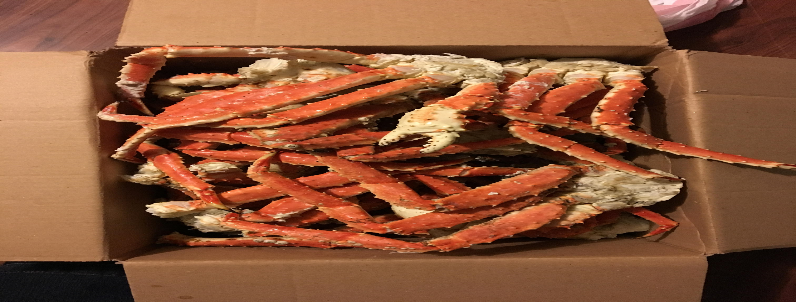
Linkages
Kawerak actively participants in established collective impact work-groups who create regional opportunities, projects and initiatives to improve the educational and job-related outcomes for Alaska Native people in the Bering Strait region.
Postsecondary Preparation and Transitions Success Workgroup (PPTS). Consists of all regional organizations to include but not limited to, Alaska Department of Labor and Workforce Development School Districts, University of Alaska Fairbanks, College and Career guides, Extension schools, Tribal Governments and local Vocational Training Center. PPTS has a vested interest in Post-secondary education and guided Career pathways for Tribal members in the Bering Strait region.

Slide 18
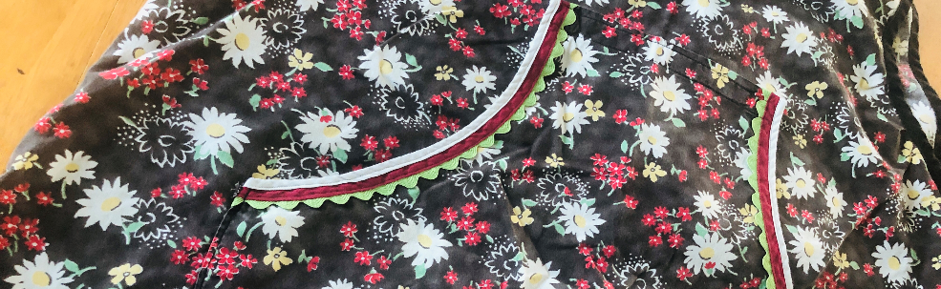
Linkages
The Bering Strait Health Consortium: The Health Consortium holds regular monthly meetings that aim to foster more Alaska Natives from the Bering Strait region to pursue career pathways in the healthcare fields. Kawerak, University of Alaska Fairbanks Northwest College, Norton Sound Health Corporation, Nome Eskimo Community, Alaska Department of Labor and Workforce Development, Northwestern Alaska Career and Technical Center and the Fairbanks Allied Health Consortium co-coordinated and co-funded a Certified Nurse Assistant Program each year. In 2018, six regional residents completed the CNA program.

Slide 19
Linkages
Northwestern Alaska Career and Technical Center (NACTEC): NACTEC is a training program in the Bering Strait region that coordinates a wide range of vocational training programs for in-school youth. NACTEC is centrally-located in Nome. Most students who attend are enrolled in the Bering Strait School District and reside in the small rural village communities. Kawerak has partnered with NACTEC throughout the year on various projects, such as the Certified Nurse Assistant training program, which was available to youth as well as adults, and provided career development, job search, and soft skills training to youth enrolled in NACTEC courses. In 2018, Kawerak and NACTEC coordinated adding an Adult Driver’s Course which 20 adults received their Driver’s license.

Slide 20
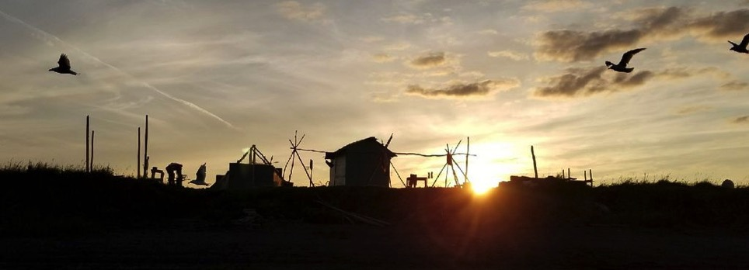
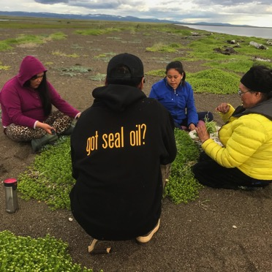

Stay Connected
Huda Ivanoff
www.kawerak.org
Agnes Takak

Slide 21
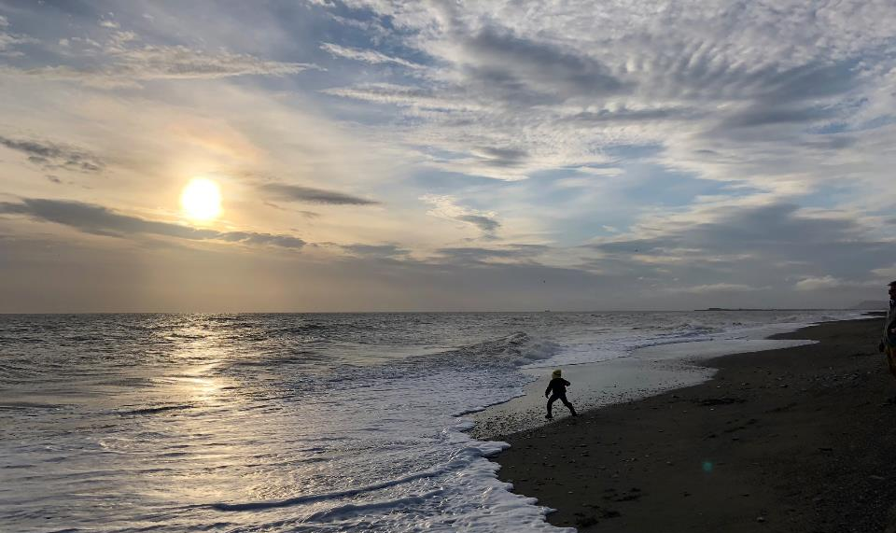
Quyaana!

